Slide 1
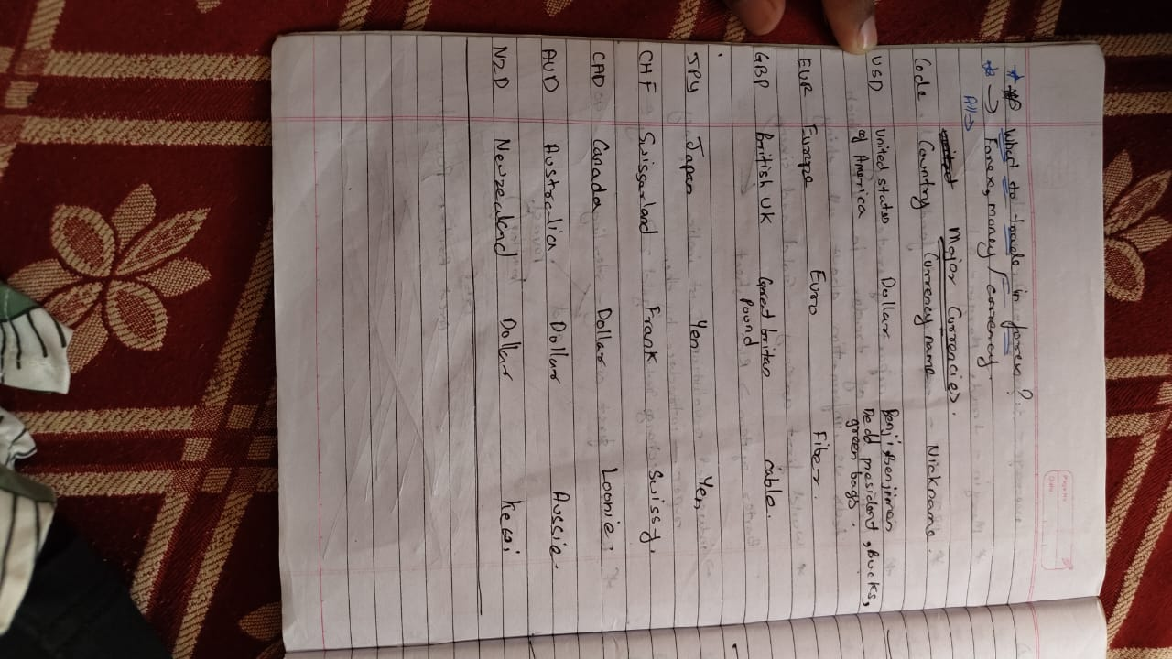

Slide 2
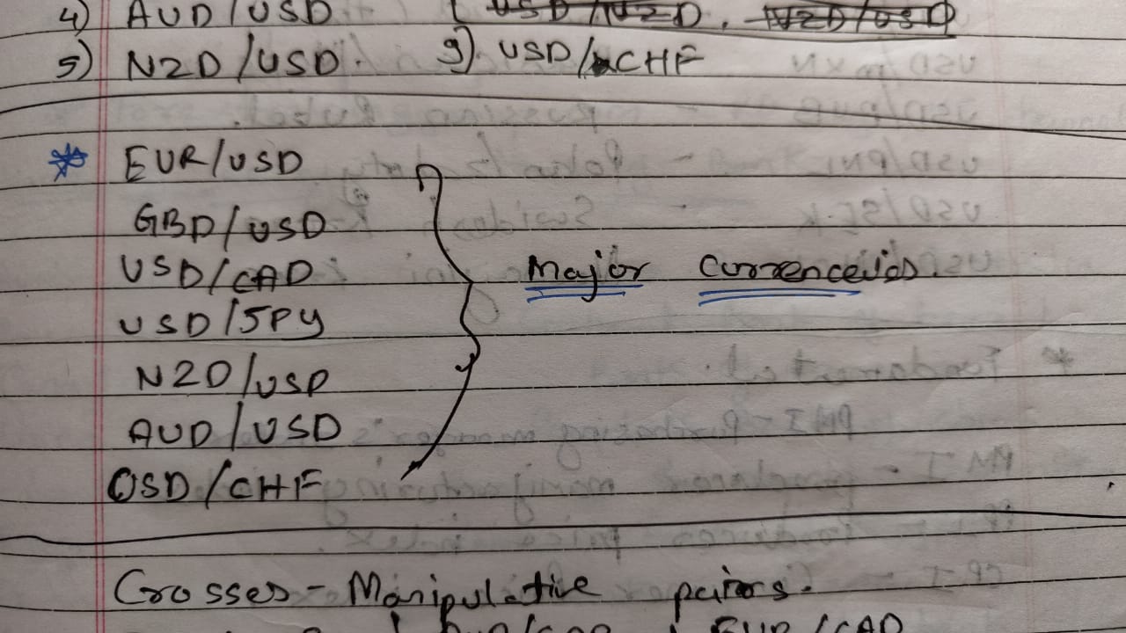

Slide 3
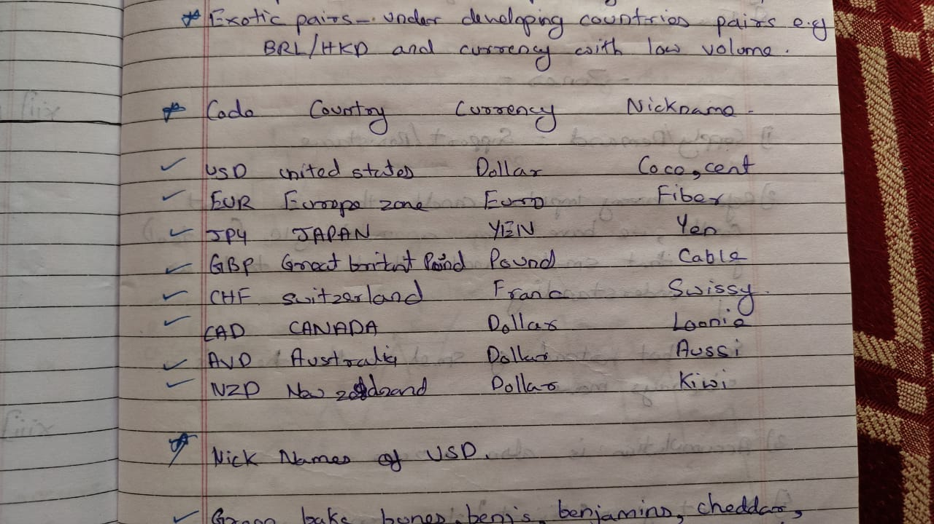

Slide 4
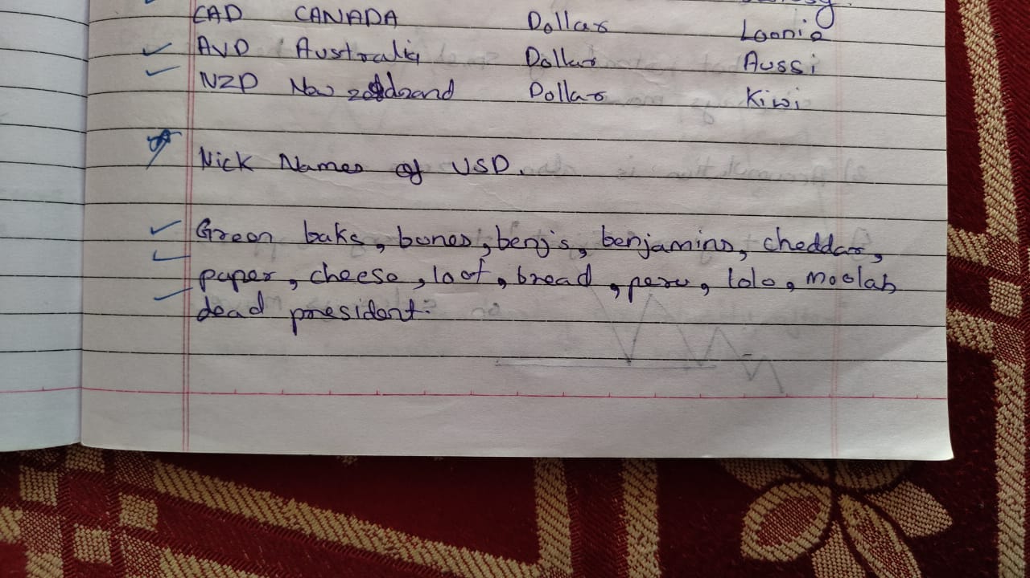

Slide 5
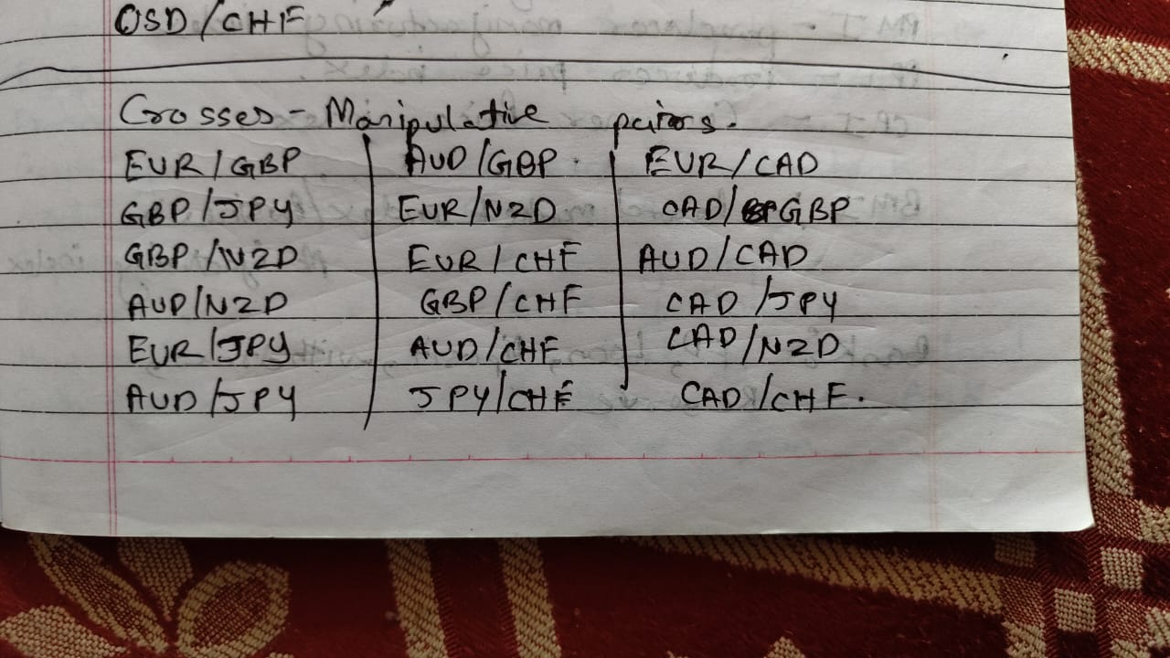

Slide 6
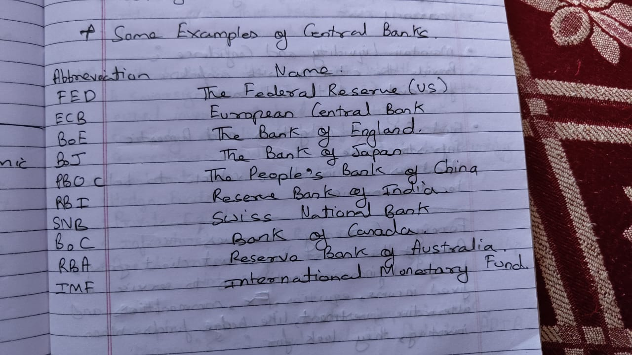

Slide 7
TRADING SESSION | OPENING INDIAN STANDARD TIME (IST) | CLOSING INDIAN STANDARD TIME (IST)
Wellington (Pacific session) | 3:30 AM | 10:15 AM
Sydney (Pacific session) | 5:30 AM | 12:30 PM
Tokyo (Asian session) | 5:30 AM | 2:30 PM
Hong-Kong and Singapore (Asian session) | 6:30 AM | 2:30 PM
Frankfurt (European session) | 11:30 AM | 7:30 PM
London (European session) | 12:30 PM | 8:30 PM
New York (North American session) | 5:30 PM | 2:30 AM

Slide 8
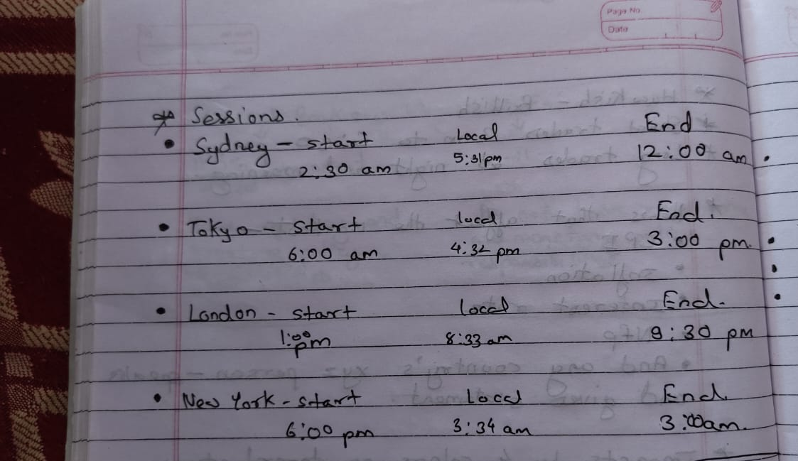

Slide 9
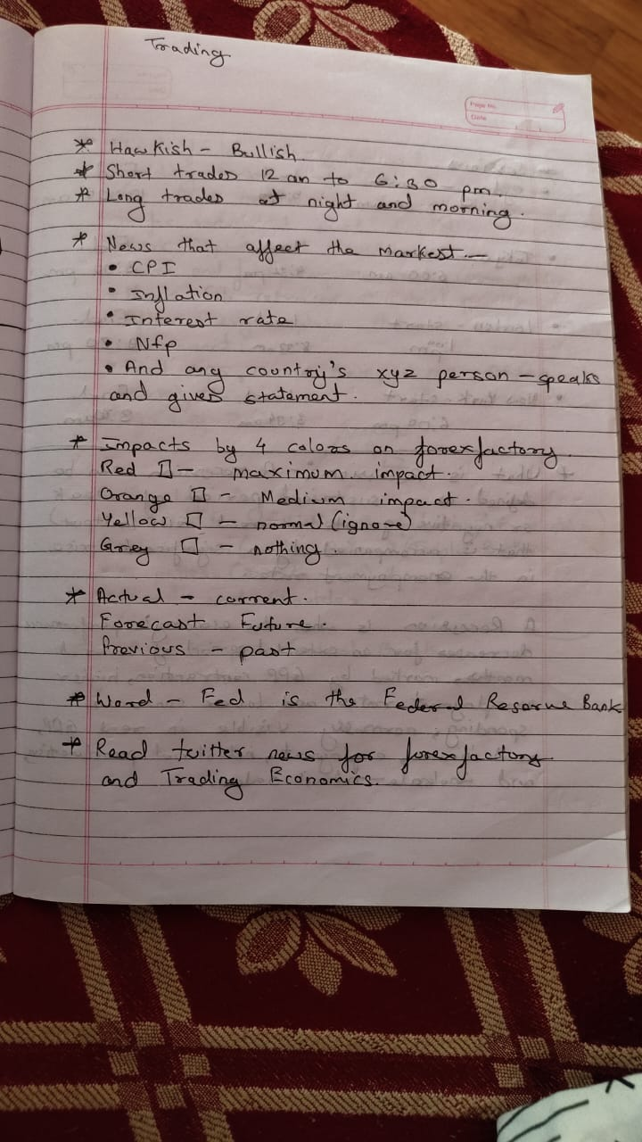

Slide 10
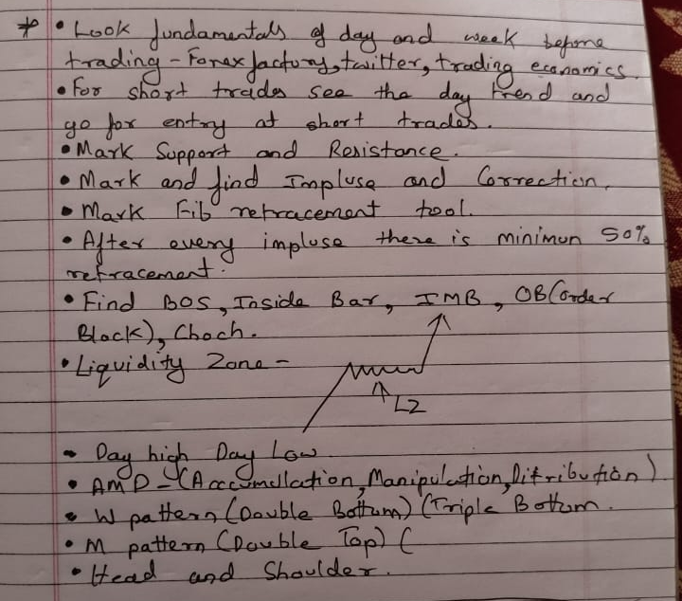

Slide 11
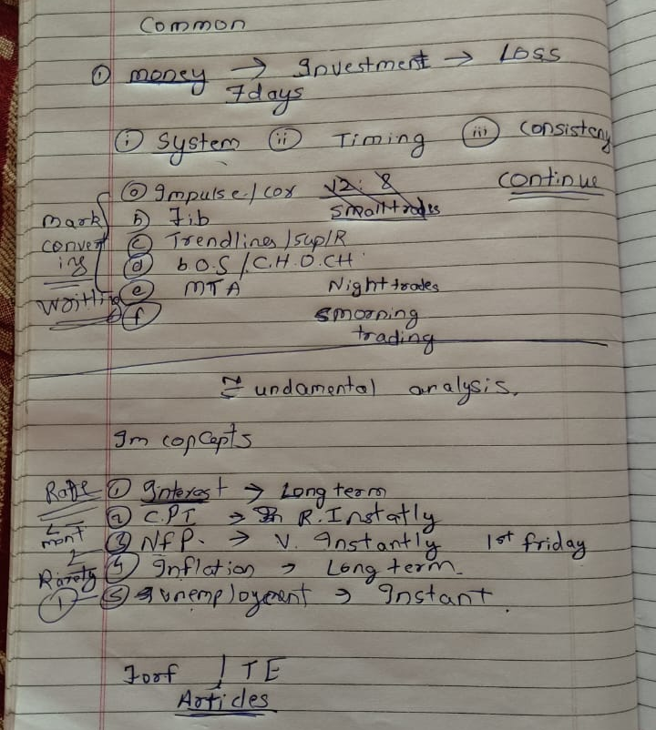

Slide 12
Consumer Price Index (CPI) and Federal Open Market Committee (FOMC):
Released monthly, about 16 days after the month ends:
Date 13/09/2022.
Consumer prices account for a majority of overall inflation. Inflation is important to currency valuation because rising prices lead the central bank to raise interest rates out of respect for their inflation containment mandate;

Slide 13
Top things you should avoid as a trader
Trading requires training and discipline. Success is possible, and if you want to become a successful trader, you need to put in the hours and work for it.

Slide 14
Fundamental Analysis

Slide 15
What Is Fundamental Analysis
Fundamental Analysis is a broad term that describes the act of trading based purely on global aspects that influence supply and demand of currencies, commodities, and equities.

Slide 16
Central Banks
Central banks are likely one of the most volatile sources for fundamental trading. The list of actions they can take is vast; they can raise interest rates, lower them (even into negative territory), keep them the same, suggest their stance will change soon, introduce non-traditional policies, intervene for themselves or others, or even revalue their currency. Fundamental analysis of central banks is often a process of poring through statements and speeches by central bankers along with attempting to think like them to predict their next move

Slide 17
Geopolitical Tensions
some countries around the world don’t get along very nicely with each other or the global community and conflicts or wars are sometimes imminent. These tensions or conflicts can have an adverse impact on tradable goods by changing the supply or even the demand for certain products. For instance, increased conflict in the Middle East can put a strain on the supply of oil which then makes the price increase. Conversely, a relative calm in that part of the world can decrease the price of oil as supply isn’t threatened. Being able to properly predict how these events will conclude may be a way to get ahead of the market with your fundamental perspective.

Slide 18
Key Economic Announcements
it is important to know which announcements are going to create the most impact and volatility so as to take advantage of their movements. Here are some of the most widely revered events and their meaning.

Slide 19
Employment
Whether we’re talking about Non-Farm Payrolls (NFP) in the US or Employment Change in Australia, economic announcements about jobs are an incredibly important measure of the growth or contraction of a particular region. Many of the central banks around the world have “healthy employment” or some derivative of that as one of their mandates. So if employment isn’t performing up to the level they would prefer, they could adjust their monetary policy to boost it, therefore influencing a variety of other factors as well.

Slide 20
Consumer Price Inflation (CPI)
Almost always lumped in with employment on the mandates of central banks around the world is “price stability.” While there are plenty of measures for inflation including Producer Price Index (PPI), Import/Export Prices, Food Price Index (FPI), Retail Price Index (RPI), Wholesale Price Index (WPI), among others, the CPI is usually the most respected due to its proximity to the consumer. Most developed economies prefer their CPI to be around 1%-3%.

Slide 21
Central Banks

Slide 22
Central Bank Meetings
One of the reasons we watch other economic announcements so diligently is to try and predict what the central banks will be doing with their future monetary policy. Therefore it only makes sense that we play close attention to what they actually do when they make their decisions as well. Interest rate hikes or cuts, forward guidance on future policy, or even introduction of unconventional measures are things we have come to expect from these meetings and their effects are both immediate and long lasting

Slide 23
Central Banks
Central Banks are responsible for overseeing the monetary system for a nation (or group of nations); however, central banks have a range of responsibilities, from overseeing monetary policy to implementing specific goals such as currency stability, low inflation and full employment.
There are eight major central banks today:
US Federal Reserve Bank (US)
European Central Bank (EUR)
Bank of England (GBP)
Bank of Japan (JPY)
Swiss National Bank (CHF)
Bank of Canada (CAD)
Reserve Bank of Australia (AUD)
Reserve Bank of New Zealand (NZD)

Slide 24
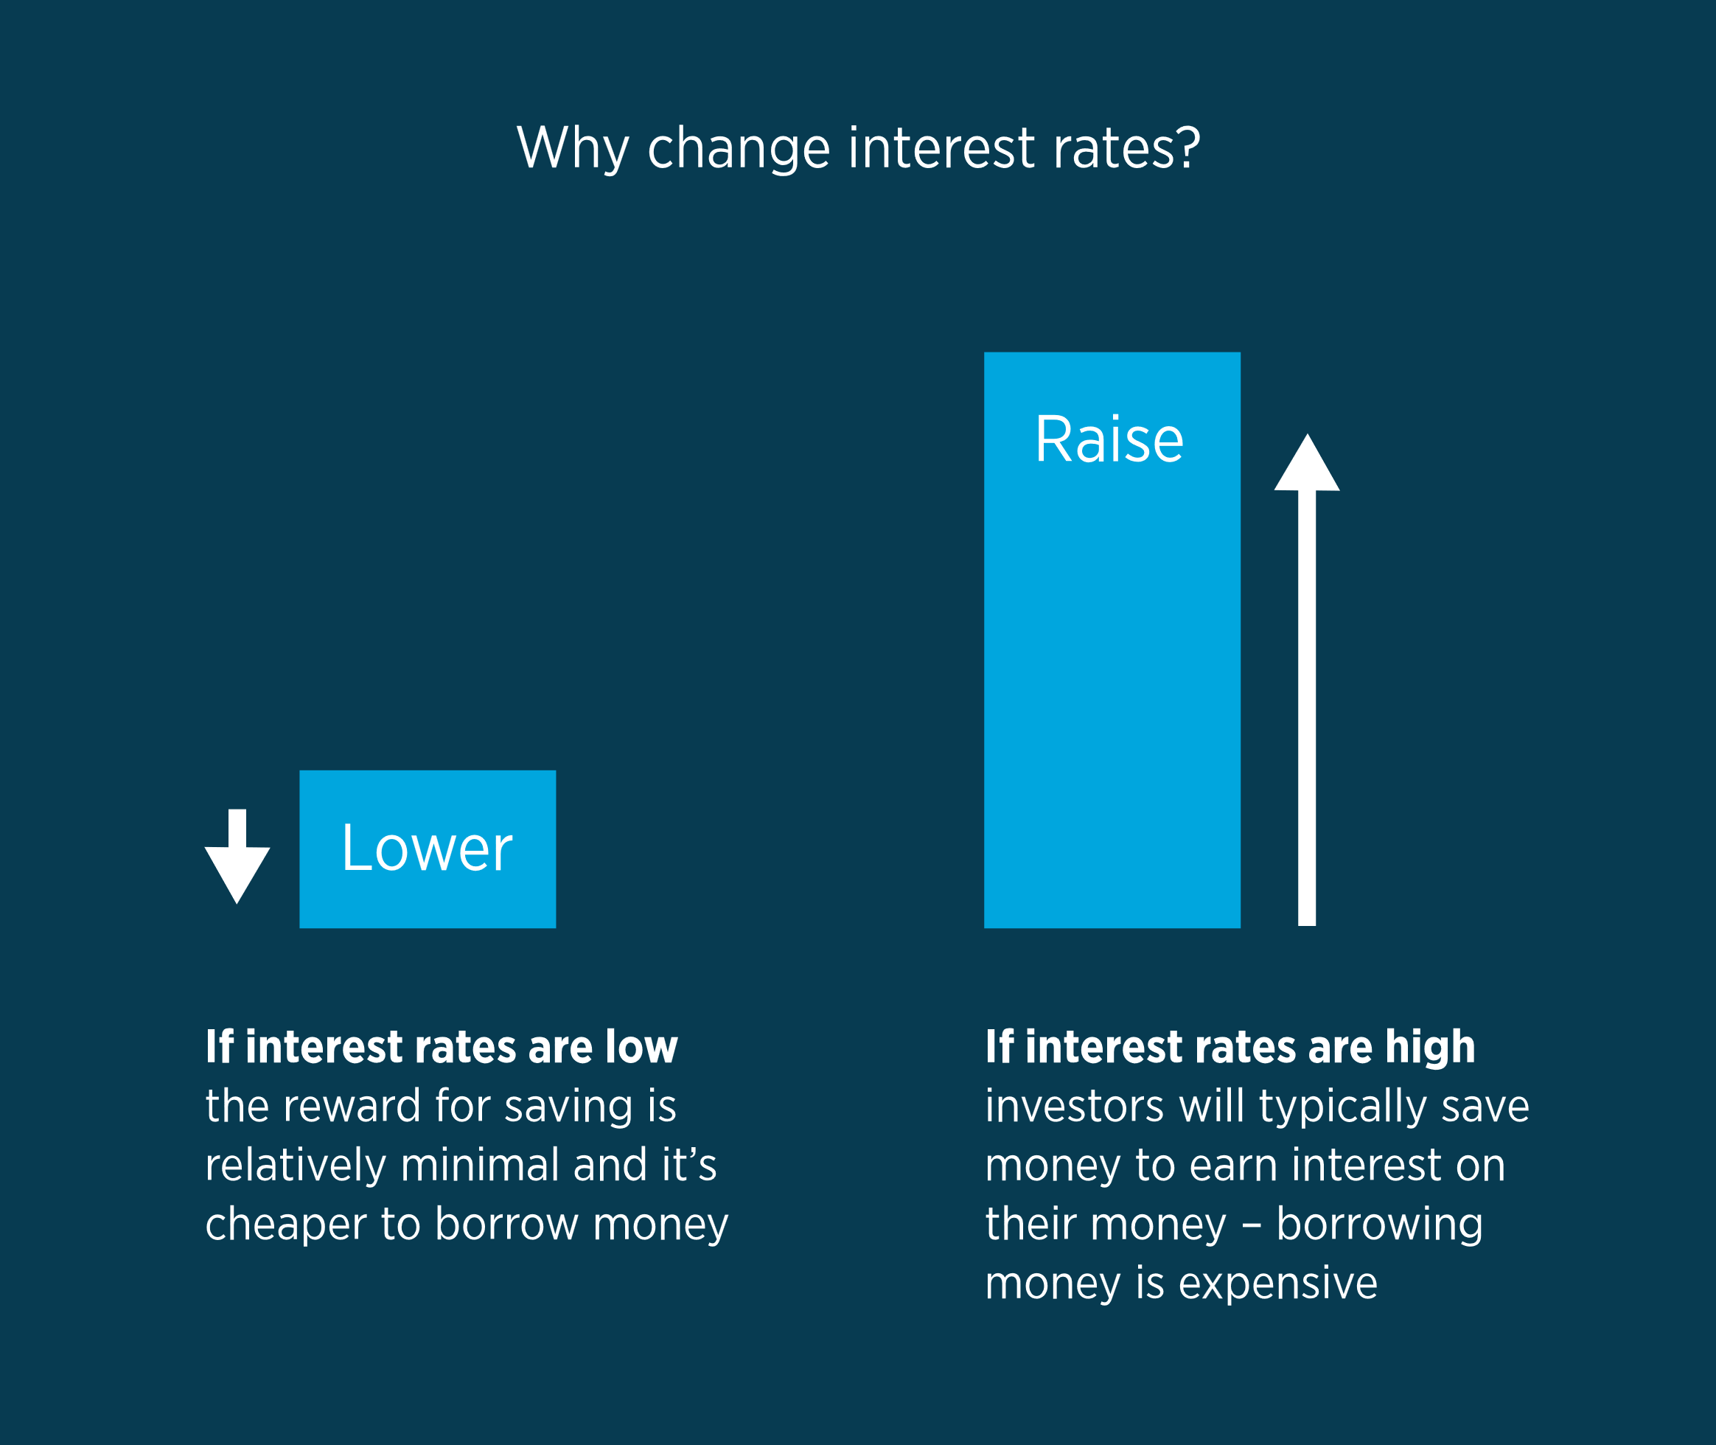
Central Banks and Interest Rates
The balancing act of stable employment and prices is a tricky one, and the main mechanism a central bank has to regulate these levels is interest rates. Interest rates are a primary influencer of investment flows.

Slide 25
High interest rates
In this environment, high interest rates will encourage banks to hold on to their money. Why? Because they can earn a good return by keeping it with the central bank, where they know it is safe. So they will in turn charge higher interest on loans – as they present a relatively higher risk.
This makes it more difficult and expensive to borrow money. Small businesses may keep their purse strings tight, and prospective homebuyers may be priced out of mortgages. Spending remains low overall and the economy continues to struggle.

Slide 26
Low interest rates
However, if the Federal Reserve (the Fed) reduces interest rates, holding on to capital looks a lot less compelling. Banks can no longer make much return from keeping money with the Fed, but they can borrow it at a low cost.
That means they can offer low interest rates on loans to businesses and individuals. These loans are now worth the risk, because there isn't a safer option readily available.
With more access to cash and lower rates on their savings accounts, those businesses and individuals are encouraged to spend and invest. The higher spending kickstarts the economy into growth.

Slide 27
Central bank meetings
Each central bank will have its own regular meetings. For example, the Federal Open Market Committee (FOMC), which sets monetary policy for the Federal Reserve, usually meets eight times a year.
Traders will watch for any announcements from each meeting, such as rate hikes or cuts, forward guidance on future policy, or any other new monetary measures (such as quantitative easing).
However, traders and investors usually won’t just wait until an official rate announcement before taking a position. Instead, they will scour multiple sources for any clues as to what a central bank might do.
Central banks pay a lot of attention to various economic indicators when deciding their next course of action. Traders will also pore over these releases and attempt to anticipate what is about to happen.
They'll also pay attention to the key staff at a central bank, to ascertain whether important decision makers are hawks or doves:
1] Hawks are proponents of higher interest rates to fight inflation
2] Doves want lower interest rates to promote economic growth

Slide 28
What is Quantitative easing?
You might have heard of central banks using Quantitative easing (QE) whent the economy is struggling. This is a method of cutting interest rates where a central banks will cash in some of its holdings and buy bonds (usually long-term bonds.)
By entering into the long-term bond market, the central bank increases demand for those bonds, therefore driving down the interest earned on them. The goal of such a measure is to keep interest rates low to encourage more borrowing. QE is often used when interest rates are already at rock bottom.

Slide 29
Central bank interventions
Sometimes the value of a currency can inflict harm on an economy, which can lead to its central bank stepping in.
Japan’s economy is dependent on exports, for example. Countries with high exports tend not to want their currency to gain too much value. Take a look at the table below to see why.
If the yen is too strong against the dollar, then Japanese exporters make much less money. They might have to increase their prices, which could see overall sales fall. In this instance, the Bank of Japan might flood the market with JPY by releasing reserve cash. This supply glut should cause the yen to depreciate, meaning USD/JPY rises.
Taking advantage of intervention is particularly challenging because unlike interest rate changes, it isn’t usually communicated to the masses until after it has occurred.
However, there may be clues that intervention is about to be implemented, particularly if a central bank repeatedly states that its currency is overvalued. Though the timing of it is difficult to gauge and is usually a surprise.
USD/JPY VALUE | PRICE OF TV IN USD | REVENUE IN JAPAN
80 | $100 | ¥ 8,000
100 | $100 | ¥ 10,000
120 | $100 | ¥ 12,000

Slide 30
Inflation

Slide 31
Inflation and CPI
Inflation is a crucial factor in economics and plays a key part in fundamental analysis. Let’s take a closer look at what inflation, hyperinflation, and deflation all really mean, and how inflation is measured.
Central Banks must maintain a tricky balancing act. Most have a dual mandate of maintaining high employment while keeping prices stable – and to keep prices stable you need to manage inflation.

Slide 32
What is inflation?
Inflation is the term for when prices rise over time in an economy. It gets its name because prices are being inflated higher each year, just like blowing up a balloon.
While rising prices might seem like a bad thing, they are part of a growing economy. Most economists today believe that a low and stable inflation rate can help reduce the severity of economic downturns by providing a cushion against falling prices, which can be difficult to manage if they become entrenched.
For this reason, central banks will try to keep inflation within acceptable parameters. The Bank of England, for example, has a target of 2%. This means that prices overall should increase by 2% each year.
If inflation drops below 2%, it may consider lowering interest rates to boost the economy and get it back on track. If it goes too high, they could raise rates to slow the economy. Otherwise, they run the risk of hyperinflation.

Slide 33
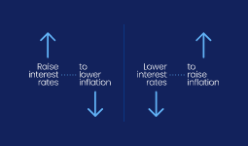

Slide 34
What is hyperinflation?
Hyperinflation occurs when inflation gets out of control. Prices get too high, and the value of currency plummets. Classic examples include Germany before WW2, Russia after the fall of the Soviet Union and Zimbabwe in the mid-2000s.

Slide 35
What is deflation?
Deflation arises when prices are declining – so inflation is below 0%.
To the average person on the street, deflation might seem like a good thing. Who wouldn’t want the things they buy every day to get cheaper?
Well, manufacturers and producers, for one. Deflation means that the margin they make from sales would go down, which hurts their bottom line and may lead to layoffs. As unemployment rises, demand falls, and companies are hurt even more. And what does this lead to? Even more job losses.
This is called a deflation spiral.
To avoid this spiral, central banks may consider easing monetary policy when inflation falls.

Slide 36
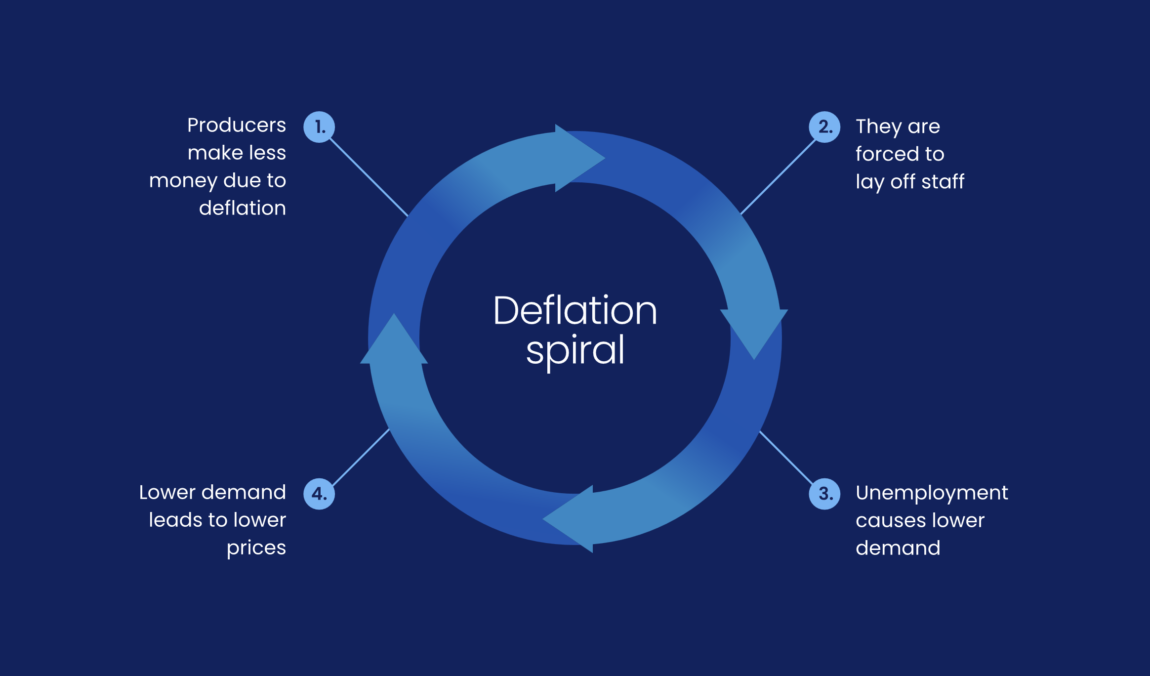

Slide 37
Reflation and disinflation
These describe changes in the inflation rate:
Reflation is when the inflation rate is going up
Disinflation is when it is going down
In the 1990s and 2000s, the Bank of Japan struggled to reverse a stubborn disinflation trend. During this period, inflation remained low and the economy stagnated in a period known as the ‘lost decades’.
As 0% interest rates failed to kickstart consumerism or business activity, with the BoJ eventually turning to quantitative easing, in which a central bank buys bonds and asset-backed securities to increase money supply and introduce inflation.

Slide 38
Consumer Price Index (CPI)

Slide 39
What is the Consumer Price Index (CPI)?
The Consumer Price Index (CPI) is an economic indicator that tracks the cost of goods and services and serves as an important statistic for identifying inflation or deflation. Known also as headline inflation, it is a major influencer of interest rate changes based on the inflation targets set by central banks.
goods and services such as groceries, transport costs, and healthcare
When the amount of the currency needed to buy the market basket increases, this is inflation, and when the amount of currency needed to buy the market basket decreases, this constitutes deflation.
The core CPI figure is slightly different as while it still measures the change in price of goods and services, it does not include energy and food prices. These are omitted for this measure as such prices have the tendency to be highly volatile and therefore capable of creating a misleading impression of inflationary pressures.

Slide 40
When is CPI released?
In the US, the CPI is released monthly by the US Bureau of Labor Statistics and has been reported since 1913. However, in countries such as Australia, the data is released on a quarterly basis, and in Germany, an annual report is issued.
In the US, the CPI is released monthly by the US Bureau of Labor Statistics and has been reported since 1913. However, in countries such as Australia, the data is released on a quarterly basis, and in Germany, an annual report is issued.
When is CPI released?

Slide 41
How the CPI affects forex
Higher inflation in the form of a higher CPI naturally makes an individual unit of currency worth less, as there are more units of that currency needed to buy a given item.
But more importantly, as with the NFP and GDP, when the CPI changes, central bank monetary policy may follow suit.
High CPI may inspire interest rate hikes by a central bank in an attempt to control the inflationary trend. When a country’s interest rates are higher, it is likely that its currency will strengthen as demand for it increases.
Conversely, lower inflation may lead to decreased interest rates and weaker demand for a country’s currency, prompting consumers to spend, putting more money into circulation, and generally stimulating a slower economy.
So given this information, it’s no surprise that when CPI data is released, forex swings can happen in kind. Sometimes it can create volatile conditions with extreme movement, creating potential for large profits, as well as proportionate risks.

Slide 42
CPI trading strategy
The Consumer Price Index can move forex, which means there are numerous strategies for trading it.
To trade the CPI, you’ll need to be aware of the expectations the market holds for inflation and the likely outcomes for the currency if these expectations are met or missed.
Sometimes, an environment for increased inflation will be welcomed (for example, when deflation is rife), while in more inflationary conditions an increased rate of inflation may be considered bad for the economy.
Analyst expectations for inflation are released on a monthly basis, with their judgments based on supply and demand dynamics, currency prices, and key commodity prices, as well as fiscal and structural measures.
After the CPI release and surrounding analysis, you might want to bring in technical elements to your approach, examining if the price is reacting to key support and resistance levels. Technical indicators may help to give some insight into the short-term strength of the move, for more informed trading decisions.
However, as with other news releases, timing is everything. It may, therefore, be unwise to open a position shortly before an announcement, as forex spreads may widen substantially immediately before and after the report.

Slide 43
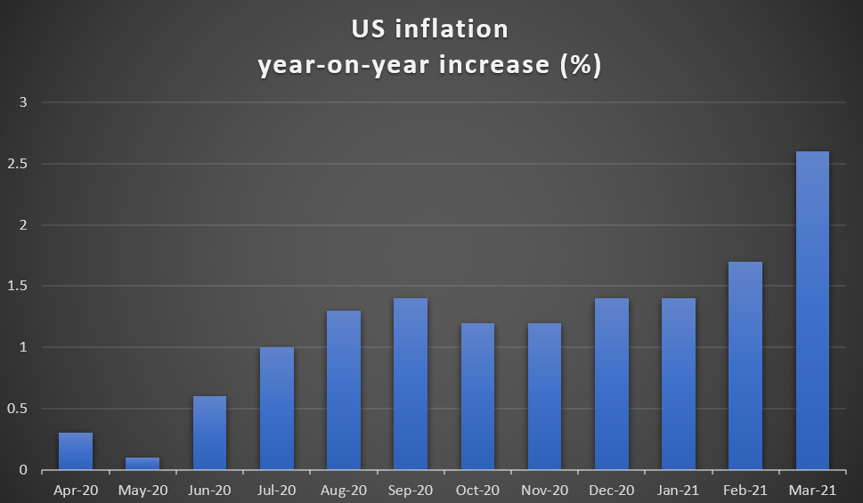
CPI example
In the below chart, US inflation statistics are shown as a percentage of change since the same point 12 months ago. So, for the March 2021 figure, consumer prices were 2.6% higher than at the same point the previous year.

Slide 44
For US traders, the US Dollar Index (USDX), which shows the performance of USD against a basket of other currencies, can be a useful way of exploring the effects of CPI data. If the latest release is divorced from analyst expectations, traders may watch for USDX to move accordingly.
On the March 2021 CPI figures (which were released the following month), USD briefly spiked as the mark was slightly above analyst expectations. However, as it became clearer that interest rate hikes were likely off the agenda for 2021, the USDX fell, a slump aided by languishing US treasury yields.

Slide 45
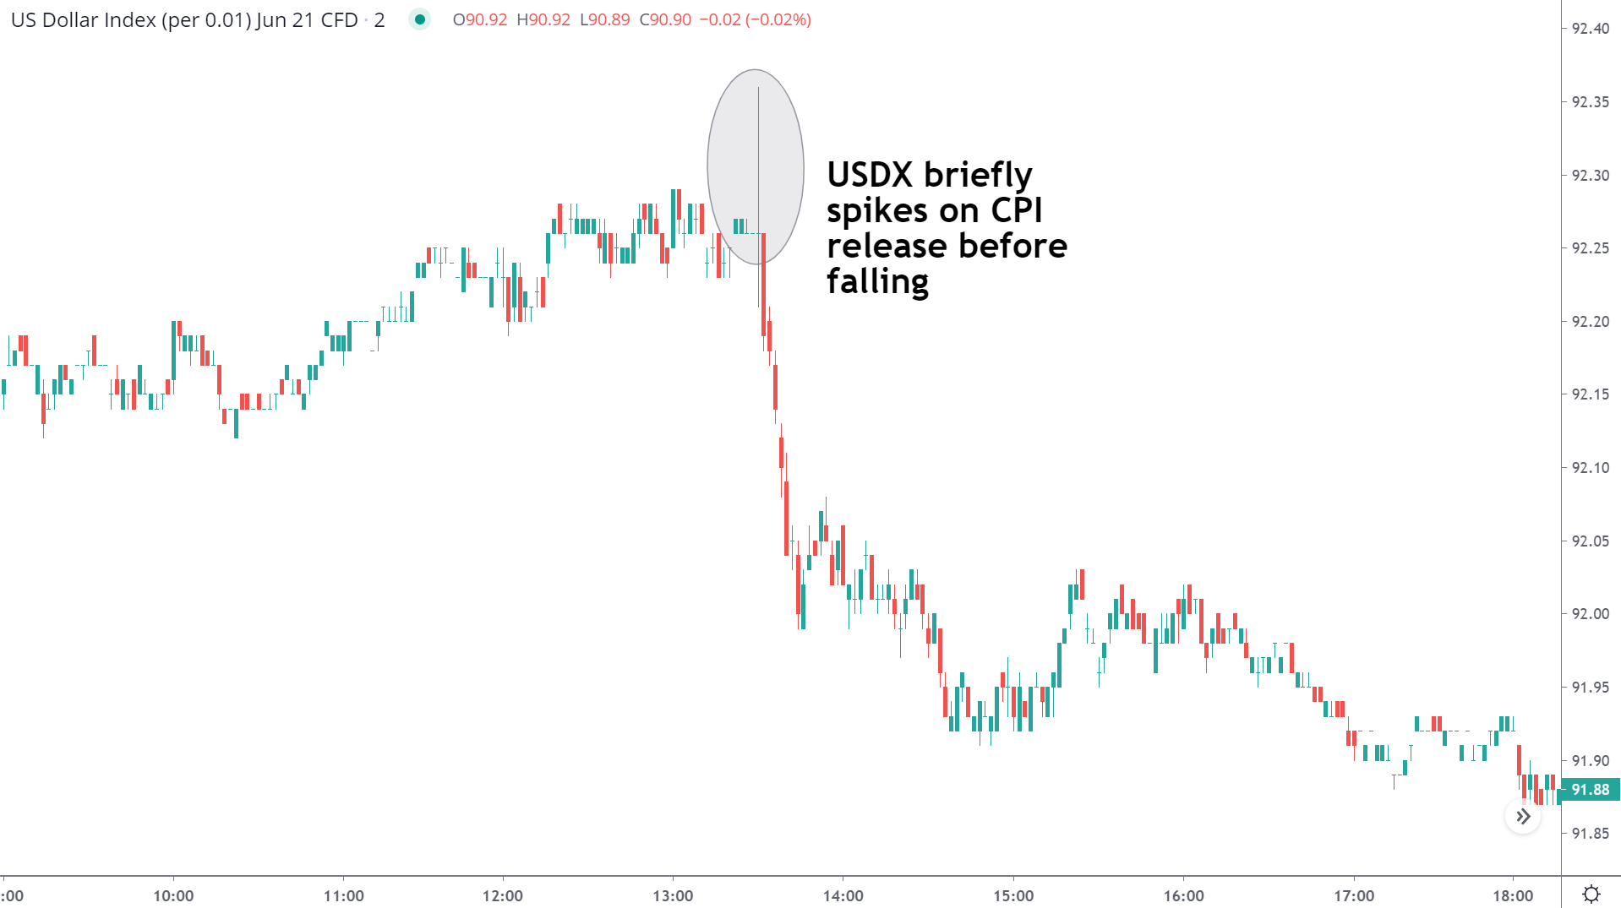

Slide 46
CPI takeaways for forex traders
CPI is a major indicator used for determining the rate of inflation
The measure helps central banks to maintain price stability
Significant forex swings can occur when releases don’t align with analysts’ expectations
Time your entries carefully so as not to get caught by widening spreads
Consider using other economic indicators in conjunction

Slide 47
Gross domestic product (GDP)
GDP is the market value of all goods and services produced by labor and property within a given economy. The Bureau of Economic Analysis (BEA) says it’s “the most closely watched measure of the US economy.”
According to the BEA, the United States had a GDP in excess of $23.3 trillion in 2021.
The data is collected through various agencies at different times, and the BEA makes adjustments as necessary to ensure the data is consistent. GDP movement is usually given as a percentage, as in the rate that GDP grew (or shrank) from one quarter compared with the previous quarter.
GDP is usually released on a regular basis. In the US, for example, the BEA published GDP data 19 times in 2021.

Slide 48
The full schedule is available from the Bureau of Economic Analysis website and many forex traders will save the individual dates to their calendars to help formulate and guide their activity. You can also plan your trading around global GDP releases using the FOREX.com economic calendar.
In principle, the data is released on a quarterly basis by the BEA four weeks after each quarter ends. However, there are further adjustments and revisions with the final GDP data released three months after the relevant quarter ends.

Slide 49
What price action can GDP trigger?
three different categories.
1] A lower-than-expected GDP reading will likely result in dollar weakness and trigger pressure on the dollar side of all relevant currency pairs. This will be exaggerated and potentially trigger more volatility if the GDP data is particularly far off the expected range
2] A higher-than-expected reading will likely lead to trading support for the dollar versus other currencies. As with point #1, the higher the GDP reading is, the greater the scope is for extended dollar gains amid fluctuating charts
It’s essential to understand that one GDP data release, although important, is not enough to change the overall fundamental picture of the currency’s economy.
In addition, positive data that matches expectations is rarely a bullish signal for a currency and may even lead to its depreciation.

Slide 50
Non-farm payrolls (NFP)
The non-farm payrolls report (NFP) is a significant market event each month.
The NFP is a monthly report that estimates the net number of jobs gained in the US in the previous month, excluding those in farms, private households, and non-profit organizations. It is usually released on the first Friday of the month, in an Employment Situation report that also includes the US unemployment rate, average hourly earnings, and participation rate.

Slide 51
Why is NFP important?
The Federal Reserve has the mandate to maintain maximum employment in the US, as well as stable prices. So, they’ll pay close attention to the NFP when setting interest rate policy. If employment looks strong, the Fed may consider raising interest rates. If it is weak, lower rates could be in the cards.
As the US is the world’s largest economy, any actions by the Fed tend to have a significant impact on global financial markets. But first and foremost, they’ll have a big effect on the USD, so forex traders will monitor the NFP closely and rush to amend their strategies based on the data, or attempt to profit from the volatility.
The data is usually released on the first Friday of every month at 8:30 AM ET and reflects the previous month’s data.

Slide 52
How does NFP data affect forex?
NFP releases have a general tendency to cause large movements in the forex market.
If the Fed decides to lower interest rates to combat high unemployment, it reduces demand for the dollar, causing it’s the dollar’s price to fall.
Conversely, a high number of additional jobs (generally, anything in six figures, but particularly 200,000 or more) is likely to be a positive factor in terms of pushing USD gains. A particularly positive forecast ahead of an NFP release can have the same effect as would NFP data which radically outperforms estimates.

Slide 53
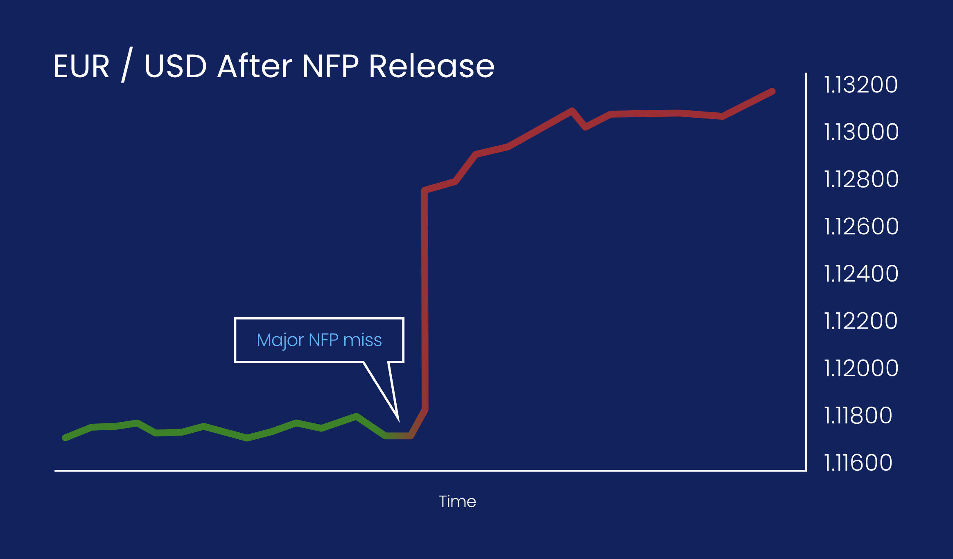

Slide 54
Some traders will consider closing all active positions before an NFP release and begin a new pattern of trades after the data is released. Alternatively, you could avoid trading during these releases altogether.

Slide 55
Is there a reliable strategy to use when reacting to NFP data?
However, there is one strategy that many traders seem to agree on. It’s what is known as the pullback strategy, in which you wait for a currency pair to retrace before entering a trade.
Let’s take a historical example: the March 2019 NFP report. The data that day revealed a highly disappointing 20,000 new jobs created against an expectation of 180,000. This data would usually harm USD, causing EUR/USD to rise.

Slide 56
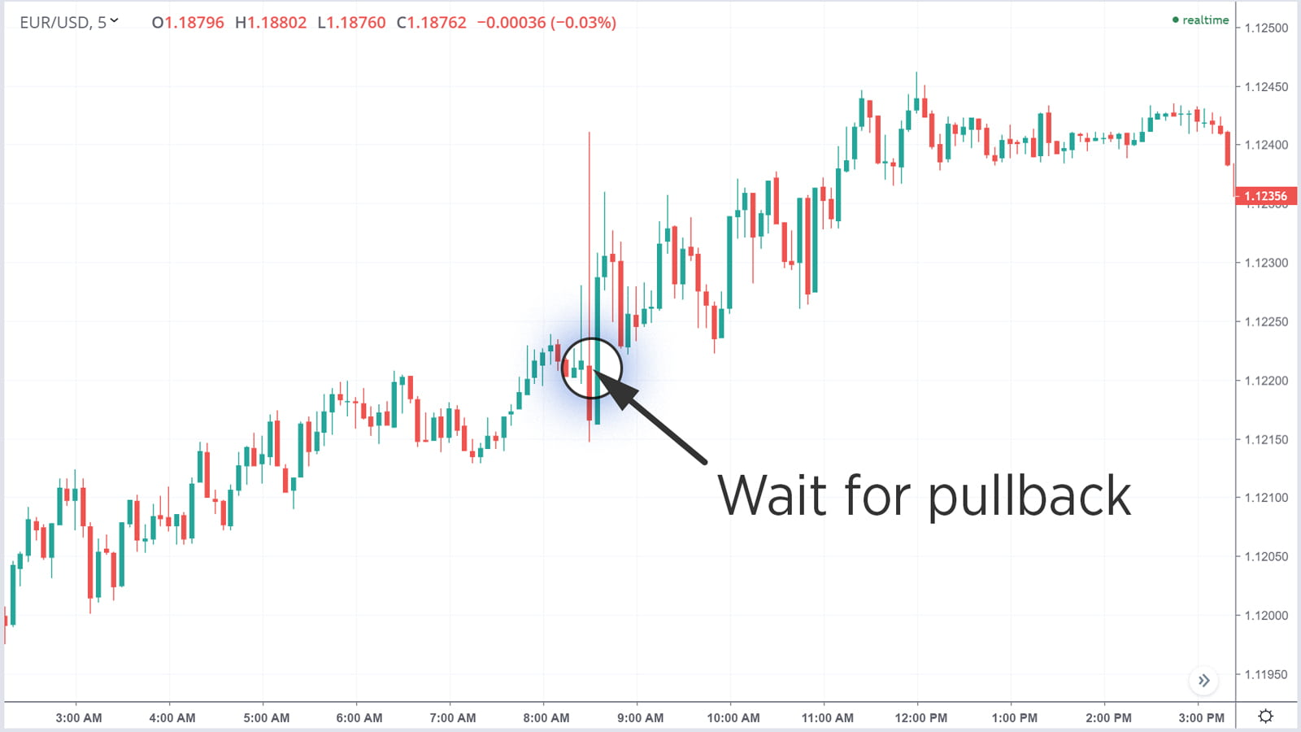

Slide 57
But as you can see, while the graph spikes up rapidly, it falls back equally quickly and in fact comes down below its pre-NFP level.
It is at this point that the pullback strategy would suggest a buy trade should be made in the expectation that the graph is ready to move back into positive territory. And indeed, that is exactly what happens. Look at the big green candle representing the next five-minute period.
We’ll cover this strategy in more detail in the Advanced trading strategies course. If you’re considering employing it, just remember that there’s no guarantee of a pullback working. And the high volatility can often bring increased risk, so using stop orders is recommended.

Slide 58
Other employment figures
Of course, the NFP only measures employment in the US. It’s also worthwhile checking the employment figures for any economy you’re focusing on in your trading, whether it’s the change in employment in Australia or the unemployment rate in the UK.

Slide 59
Key factors that affect the forex markets

Slide 60
Economic indicators and announcements
The GDP, NFP, and CPI releases might be some of the most important dates for currency traders, but there are a lot more market-moving events to pay attention to.
Here’s a quick guide covering three important economic indicators: consumer and business sentiment reports, PMI, and retail sales.
1. Consumer and business sentiment report
Multiple organizations are constantly surveying consumers and business leaders to create sentiment reports. While the number of reports they produce is staggering, they all play their part in shaping the market’s expectations for the future.
Why are consumer and business sentiment reports important?
An economy needs businesses and consumers to spend in order to thrive. If businesses and consumers are feeling apprehensive about the economy, then spending tends to be lower – which may impact growth, employment, and inflation down the line.
As such, these reports tend to be leading indicators. While employment and inflation figures are reported on past quarters, sentiment reports can give you an insight into what’s going to happen next.

Slide 61
2. Purchasing manager index (PMI)
Purchasing manager indices measure the prevailing direction of economic trends in a given industry, according to the view of its purchasing managers. They are used as an indicator of the overall health of a sector.
Like price indices, there are typically multiple different PMIs released for any given economy.
A PMI figure of above 50 indicates that managers believe that their business is performing better in the current month than the previous one
If it is below 50, then managers have seen less activity this month than the last
If it is at 50, then the current month is on par with the previous one
Why are PMIs important?
PMIs are used to get a quick on-the-ground assessment of how a sector is performing from the people working within it. If a key sector in a country is stalling, then the economy may soon follow. On the other hand, if it is thriving, growth could be on the horizon.

Slide 62
Other factors that affect the forex markets
1. Government announcements
Governments are responsible for fiscal policy, which also has a major impact on currencies.
To fund a new infrastructure project, for example, the government will have to borrow money in the form of bonds to sell to investors.
Fiscal stimulus measures are agreed upon by governments, and sometimes a vote needs to take place to make the stimulus into law. It pays to keep up to date with breaking news events to ensure you don’t miss these crucial decisions.

